Slide 1

Unreal engine advnced
Git Submission work flow

Slide 2

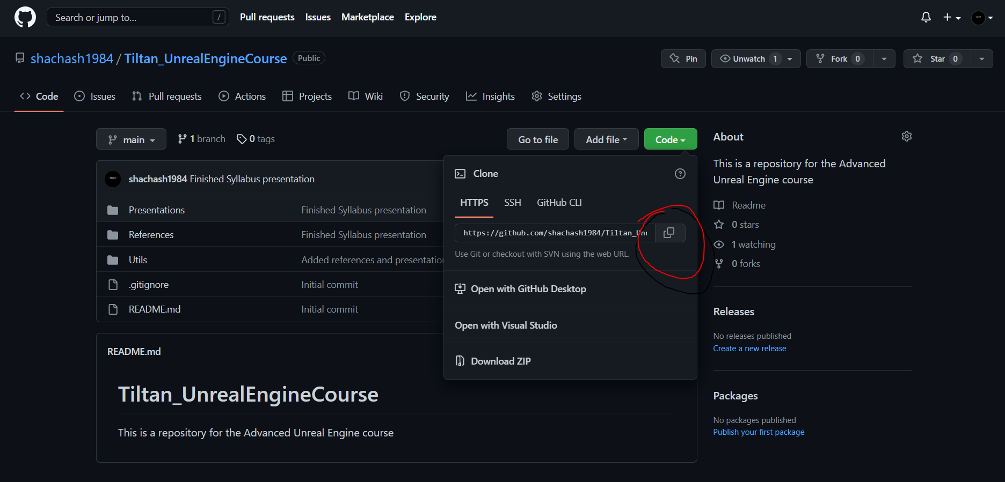
Cloning the Course repo
This Photo by Unknown Author is licensed under CC BY
This Photo by Unknown Author is licensed under CC BY-NC

Slide 3
Cloning the Course repo
This Photo by Unknown Author is licensed under CC BY

Slide 4

Creating Another branch and switching to it
This Photo by Unknown Author is licensed under CC BY

Slide 5

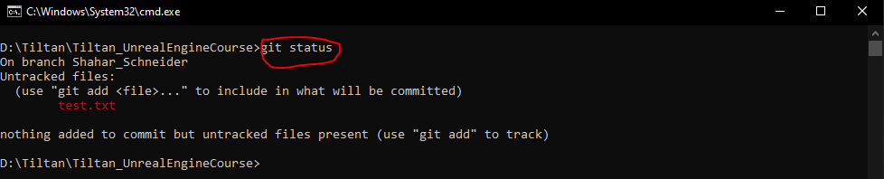
Checking current status
Local Machine
Red lines are “Unstaged” Changes, AKA: “Working tree changes”
***NOTICE***
On the second line it states your current branch, on your case it should be: “On branch FirstName_LastName”
This Photo by Unknown Author is licensed under CC BY

Slide 6
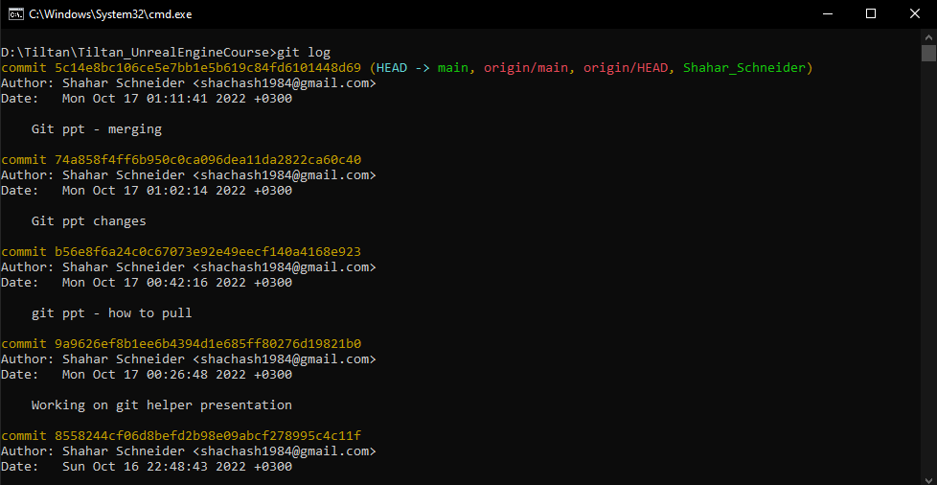
Checking the git log
Local Machine
The command “git log” shows us all the commits in the current branch
There is a cleaner version with the command “git log –oneline”
To exit the log – type ‘q’
This Photo by Unknown Author is licensed under CC BY

Slide 7
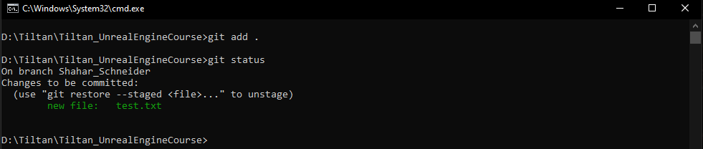
Staging your Changes
Local Machine
To stage changes we use the command: “git add [FILE/FOLDER]”
The “.” stands for current directory (which, in this case, is the root directory of the repo)
After running “git status” again we can see the lines became green – this means they are staged
Changes are now ready to be committed
Changes are now staged on YOUR LOCAL MACHINE
This Photo by Unknown Author is licensed under CC BY

Slide 8
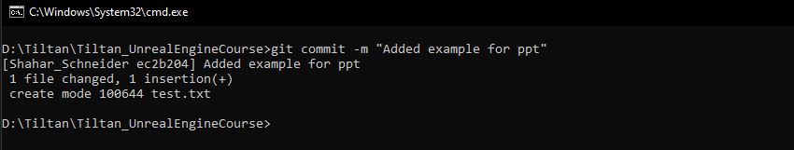
Committing your Changes
Local Machine
To commit changes we use the command: git commit –m “comments…”
These changes are now committed on YOUR LOCAL MACHINE
This Photo by Unknown Author is licensed under CC BY

Slide 9
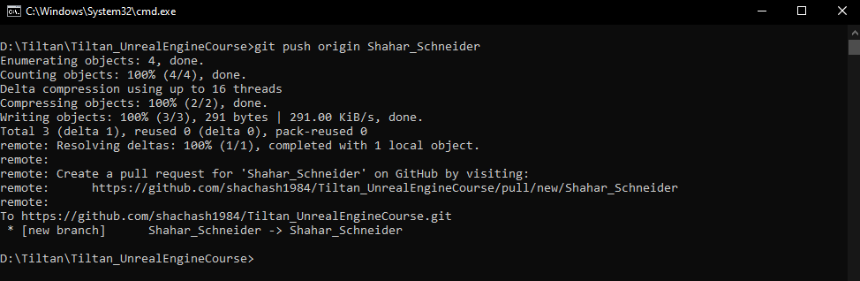
Pushing your changes to the server
Local Machine
Remote Server
After we commit changes, we need to sync the remote repo (the one on github…)
***NOTICE***:
This might require using a GitHub token. Instructions are in here:
“Tiltan_UnrealEngineCourse\Classes\Class_1\Utils”
This Photo by Unknown Author is licensed under CC BY

Slide 10
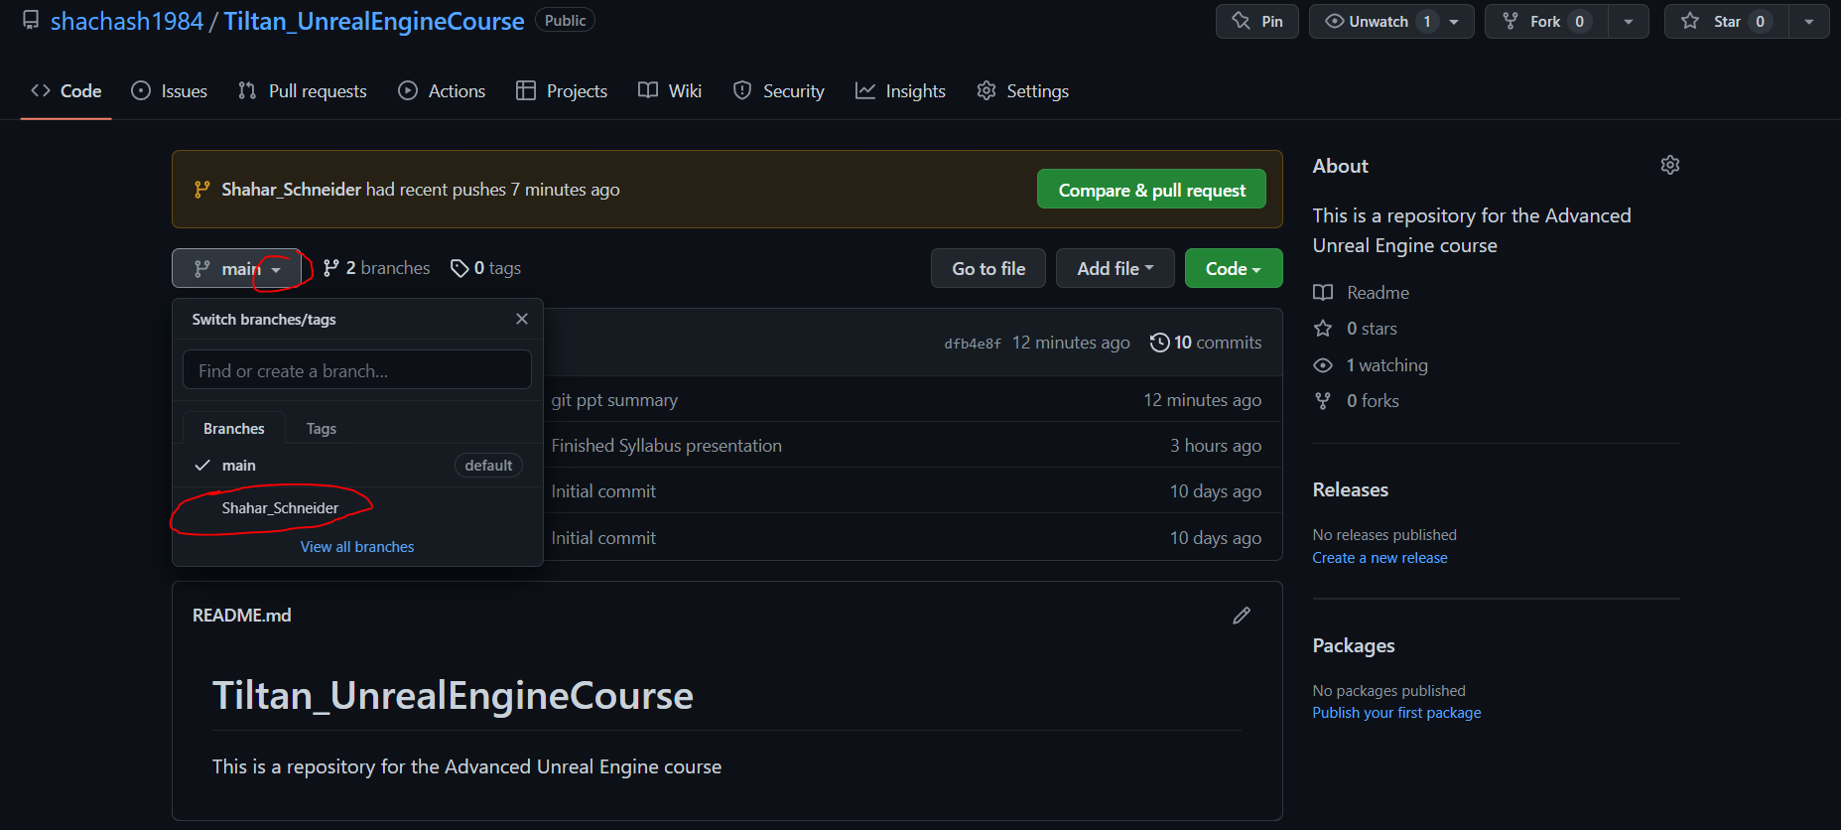
Pushing your changes to the server
Local Machine
Remote Server
After pushing the commit successfully, we can see the changes on GitHub in our branch
This Photo by Unknown Author is licensed under CC BY

Slide 11
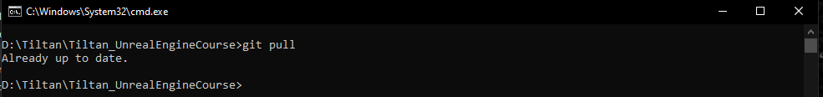
Pulling Other’s changes from the server
Remote Server
Local Machine
The command “git pull” downloads changes in the server version of the repo to our local repo
***WARNING***
Before “pulling”, make sure you have staged, committed, and pushed all your changes. Otherwise your branch might need a bit of work to be synced again
The changes you are pulling should be on other branches and not your own (probably the “main” branch or “Other_Person”’s branch
***NOTICE***
Switch to “main” branch before pulling
This Photo by Unknown Author is licensed under CC BY

Slide 12
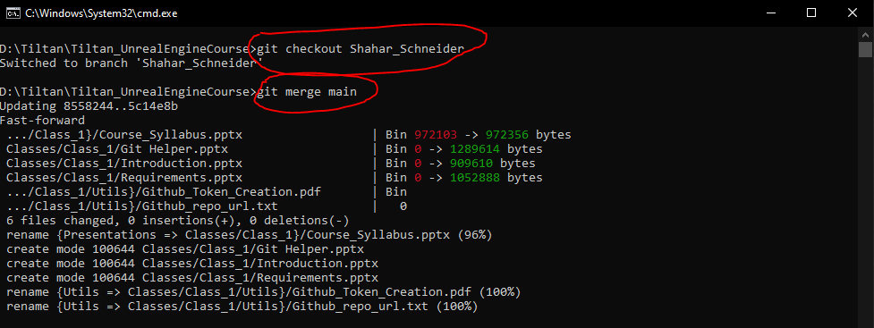
Merging the Main Branch to your branch
Local Machine
Local Machine
First we make sure we are on our branch
Then we merge the main branch
The result: we will have our branch + any NON-CONFLICTING changes made in the main branch
This Photo by Unknown Author is licensed under CC BY

Slide 13
Work flow Summary
We pull changes from the remote server
We switch to our branch
We merge the main branch to ours
We work…
We stage our changes
We commit our changes
We push our changes to the server
git commit –m “Finished final project”
On our branch
git pull
git checkout Shahar_Schneider
We make sure we are on the “main” branch
git status will help us
git merge main
git add .
git push origin Shahar_Schneider

Slide 14
Thank you!
Best of luck!

